Slide 1
Medical Assistant
Group 2
Mann – 19csu174
Shubham – 19csu304
Siddharth – 19csu307
Tanishqa – 19csu319
Tushar – 19csu323
Udit – 19csu327

Slide 2
Problem statement
Design a Java application named Medical Assistant, which contains a Medical Database class that maintains the following sets of information:
Symptom information that specifies, for each symptom recognized by the program, a set of
possible diseases that the symptom might indicate
Disease information that specifies, for each disease recognized by the program, a set of necessary symptoms that must accompany the disease
A possible diagnosis test (optional)

Slide 3
Definition of Done
The program will maintain two text files containing a list of symptoms and possible diseases, namely “symptom.txt” & “disease.txt” respectively
Two methods will be used:
a. void addSymptom(String symptom)
b. String[] diagnosis()
The patient record should be saved in a csv file namely “medicalDatabase.csv”
Apply proper validation checks on csv filename & filetype attributes

Slide 4
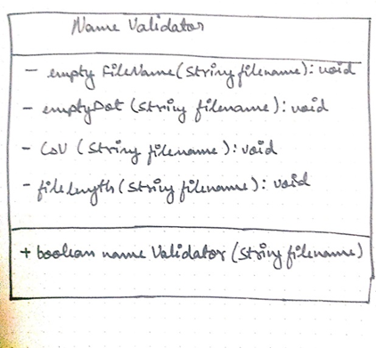
Class Diagrams

Slide 5
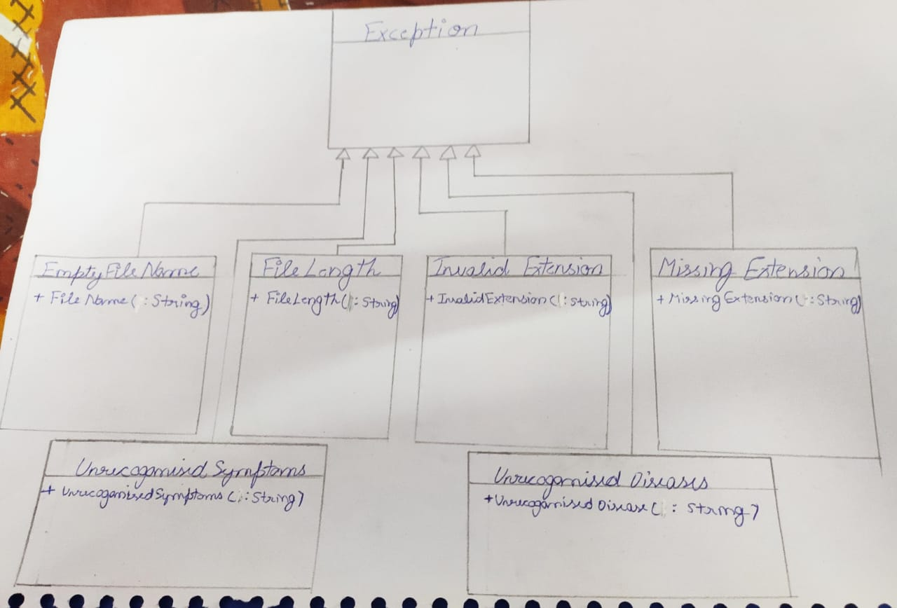
Class Diagrams

Slide 6
Class Diagrams
class mainDriver
+main(String[]args):void
class MedicalDatabase -int id -String PatientName -ArrayList<String> symptoms; -ArrayList<String> disease; +set(int id , String PatientName):void +addSymptom(String Symptom) : void +diagnosis();ArrayList<String>

Slide 7
Create Directory Structure

Slide 8
Project Directory Structure
unguidedproject
├── class
│ └── com
│ └── ncu
│ ├── exceptions
│ ├── main
│ ├── algo
│ └── validator
├── constants
├── database
├── textfiles
├── au
├── libs
└── src
└── com
└── ncu
├── exceptions
├── main
├── algo
└── validator

Slide 9
Creating the project directory structure
The project directory structure should explain about all subdirectories and what kind of files to be kept into particular sub directory.
Definition of Done -
In project root folder, following subfolders should be created.
Class
This folder should contain different packages and class files based on their actions.
Constants
This folder contains exception files

Slide 10
Creating the project directory structure
Database
This folder contains medicaldatabase.csv file.
Libs
This folder contains Opencsv-2.2.jar file.
Src
This folder should contain different packages and source files based on their actions.
Text Files
This folder contains diseases.txt and symptoms.txt files
Au
This folder contains jar file which opens csv file .

Slide 11
Exceptions created
EmptyFileNameException
FileLengthException
InvalidExtensionException
MissingExtensionException
UnrecognizedSymptomException
UnrecognizedDiseaseException

Slide 12
EmptyFileNameException
Created to check whether the file is empty or not.
package com.ncu.exceptions;
public class EmptyFileNameException extends Exception {
public EmptyFileNameException(String s ) {
super(s);
}
}

Slide 13
FileLengthException
For limiting the character length
package com.ncu.exceptions;
public class FileLengthException extends Exception{
public FileLengthException(String s){
super(s);
}
}

Slide 14
InvalidExtensionException
extensions other than .csv will not work
package com.ncu.exceptions;
public class InvalidExtensionException extends Exception{
public InvalidExtensionException(String s) {
super(s);
}
}

Slide 15
MissingExtensionException
It will identify the missing character in the extension name
package com.ncu.exceptions;
public class MissingExtensionException extends Exception {
public MissingExtensionException(String s) {
super(s);
}
}

Slide 16
UnrecognizedSymptomException
Symptoms which when not matches with our symptoms will throw exception
package com.ncu.exceptions;
public class UnrecognizedSymptomException extends Exception {
public UnrecognizedSymptomException(String s){
super(s);
}
}

Slide 17
UnrecognizedDiseaseException
If the disease not matches with the symptoms than this exception is thrown
package com.ncu.exceptions;
public class UnrecognizedDiseaseException extends Exception{
public UnrecognizedDiseaseException(String s){
super(s);
}
}

Slide 18
NameValidator Class
Contains methods to check valid file name for csv file

Slide 19
Spacing between words
public boolean nameValidator(String filename){
emptyFileName(filename);
emptyDot(filename);
String[] fileSplit = filename.split("\\." ,0);
isCsV(fileSplit[1]);
filelength(fileSplit[0]);
}
Split
Use to break /give space

Slide 20
Method to check filename is not empty
emptyFileName(filename);
private void emptyFileName(String filename) throws EmptyFileNameException{
if(filename==“ ")
throw new EmptyFileNameException("Blank File name ");
catch(EmptyFileNameException q)
{
String e=prop.getProperty("blankNameMessage");
System.out.println(e);
q.getMessage();
q.printStackTrace();
return false;
}

Slide 21
Method to check filename has a valid extension i.e. the filename contains a period(.)
Pattern method;
Pattern ob1= Pattern.compile("[.]");
which is compiled to create a pattern
emptyDot(filename);
private void emptyDot(String filename) throws MissingExtensionException{
Pattern ob1= Pattern.compile("[.]");
Matcher ob2 = ob1.matcher(filename);
if(ob2.find()==false)
throw new MissingExtensionException("No . in filename");
catch(MissingExtensionException w)
{ System.out.println(prop.getProperty("extensionMessage"));
w.printStackTrace();
return false;
}
Match method;
Matcher ob2 = ob1.matcher(filename);
This method tells whether or not this string matches the given regular expression.

Slide 22
Method to check if file is a csv file
isCsV(fileSplit[1])
private void isCsV(String filetype) throws InvalidExtensionException{
if(filetype.equals("csv")==false)
throw new InvalidExtensionException("File is not CSV type");
catch(InvalidExtensionException t)
{ System.out.println(prop.getProperty("notCsvMessage"));
t.printStackTrace();
return false;
}

Slide 23
Mehod to check filename is less than 25 characters
filelength(fileSplit[0]);
private void filelength(String filename)throws FileLengthException{
if(filename.length()>25)
throw new FileLengthException("FileName too long");
catch(FileLengthException y){ System.out.println(prop.getProperty("longFileNameMessage"));
y.printStackTrace();
return false;

Slide 24
MedicalDatabse Class
Contains methods to add symptoms and returns the list of possible disease consistent with the symptoms

Slide 25
Create the strings according to the dod’s
private String id;
private String PatientName;
private ArrayList<String> symptoms;
private ArrayList<String> disease;
public MedicalDatabse (){
id=null;
PatientName=null;
symptoms = new ArrayList<>();
disease = new ArrayList<>();
}

Slide 26
Adding symptoms
FileReader fr = null;
BufferedReader br = null;
Properties prop = new Properties();
FileInputStream input = null
try {
fr = new FileReader(“filepath");
br = new BufferedReader(fr);
String fileString;
boolean b = false;
input = new FileInputStream(“filepath");
prop.load(input);
FileReader
is an unbuffered character stream.
BufferedReader
is a buffered stream.

Slide 27
Adding symptoms
while ((fileString = br.readLine()) != null) {
if (symptom.equals(fileString)) {
b = true;
System.out.println("Symptom found in text file");
break;
}
}
br.close();
fr.close();

Slide 28
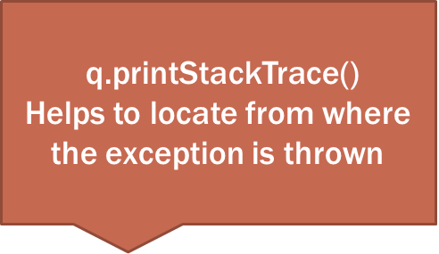
Possible exception thrown in addsymptoms
if (b == true) {
symptoms.add(symptom);
} else {
throw new UnrecognizedSymptomException("Symptom Not found in File");
}
} catch (UnrecognizedSymptomException q) {
String e = prop.getProperty("sym");
System.out.println(e);
q.printStackTrace();
} catch (Exception q) {
q.printStackTrace();
}

Slide 29
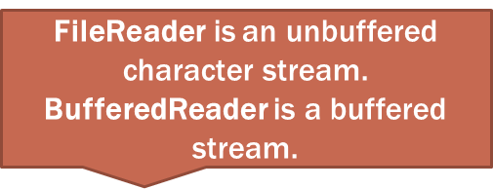
diagnosis
Properties prop = new Properties();
FileInputStream input = null; ‘
try {
fr = new FileReader(“filepath");
br = new BufferedReader(fr);
int count = 0;
String diseaseData;
String[] splitData = null;
input = new FileInputStream(“filepath");
prop.load(input);
while ((diseaseData = br.readLine()) != null) {
count = 0;
}

Slide 30
diagnosis
splitData = diseaseData.split(" ");
for (int i = 1; i < splitData.length; i++) {
for (int j = 0; j < symptoms.size(); j++)
if (splitData[i].equals(symptoms.get(j)))
{count++;}
}
}
if (count >= 2) {
disease.add(splitData[0]);
}
}
fr.close();
br.close();

Slide 31
Possible exception thrown in diagnosis
if (disease.size() == 0) {
throw new UnrecognizedDiseaseException("Diesease Not Found in File");
}
catch (UnrecognizedDiseaseException q) {
String e = prop.getProperty("dys");
System.out.println(e);
q.printStackTrace();
} catch (Exception q) {
q.printStackTrace();
}
q.printStackTrace()
Helps to locate from where the exception is thrown

Slide 32
Records Class
Methods to save data of users/patients in a csv file

Slide 33
Writedata() Method
String filePath = “filepath" +filename;
File test = new File(filePath);
try {
FileWriter outputfile = new FileWriter(test , true);
CSVWriter writer = new CSVWriter(outputfile);
FileWriter
writes directly into Files char by char
CSVWriter
used to write CSV data to Writer implementation i.e “element1” , ”element2”

Slide 34
Methoad to add header to csvfile
FileReader fr = new FileReader(filePath);
BufferedReader br = new BufferedReader(fr);
if(br.readLine()==null)
{String[] header = { "ID", "PatientName", "Symptoms" ,"Diseases" };
writer.writeNext(header); }
FileReader fr = new FileReader(filePath);
BufferedReader br = new BufferedReader(fr);
if(br.readLine()==null)
{String[] header = { "ID", "PatientName", "Symptoms" ,"Diseases" };
writer.writeNext(header);
}
FileReader is an unbuffered character stream.
BufferedReader is a buffered stream.
used to write CSV data to Writer implementation

Slide 35
Method to add data to csv
String.join()
concatenates the given elements with the delimiter and returns the concatenated string.
ArrayList<String> rec1 = ob.getSymptoms()
String Symptoms = String.join(" ",rec1);
ArrayList<String> rec2 = ob.getDisease();
String Disease = String.join(" ",rec2);
String[] data1 = { ob.getId(), ob.getName() , Symptoms, Disease};
writer.writeNext(data1);

Slide 36
Writing every exception class in the same file would be messy and not advisable to include two or more classes in same file

Slide 37
Changes in NameValidator Class
Exceptions are written in separate folder hence we need to import the exception package in the NameValidator class
Import exception classes, write at the start:
import com.ncu.exceptions.*;
package com.ncu.validator;
import com.ncu.exceptions.*;

Slide 38
Exceptions messages (properties file)
Exceptions give a message to user for any possible error
It would be better to store the messages in a file so that a single change will be applicable across project

Slide 39
Properties file
We saved properties file by exceptions.properties
Stored this file under proj_root/configs/constants folder.
blankNameMessage=" ERROR: Empty Filename Is Not Acceptable ...!"
extensionMessage="ERROR: Extension Is Missing .You Should only Give .csv Extension ...!"
notCsvMessage="ERROR: This System Accept Only Csv file ...!“
longFileNameMessage="ERROR: You have Given Long File Name .This System Accept Only Less Than 25 Characters To File Name ..!"
sym="ERROR:symptoms not found" dys="ERROR:diseaes not found"

Slide 40
Changes in MedicalDatabase class to use properties file
Properties prop = new Properties(); FileInputStream input = null;
try {
fr = new FileReader(“filepath");
br = new BufferedReader(fr);
String fileString;
boolean b = false;
input = new FileInputStream(“filepath");
prop.load(input);
while ((fileString = br.readLine()) != null) {
if (symptom.equals(fileString)) {
b = true;
System.out.println("Symptom found in text file");
break;
}
}
We use an object of FileInputStream class to create an input stream
prop.load(input);
reads a property list (key and element pairs) from the input byte stream.

Slide 41
Changes in MedicalDatabase class to use properties file
getProperty(“sym");
returns a string containing the value of the property
br.close();
fr.close();
if (b == true) {
symptoms.add(symptom);
}
else {
throw new UnrecognizedSymptomException("Symptom Not found in File");
}
}
catch (UnrecognizedSymptomException q) {
String e = prop.getProperty("sym");
System.out.println(e);
q.printStackTrace();
}
catch (Exception q) {
q.printStackTrace(); }
}
printStackTrace() is very useful in diagnosing exceptions.

Slide 42
Changes in MedicalDatabase class to use properties file
Properties prop = new Properties();
FileInputStream input = null;
try {
fr = new FileReader(“filepath");
br = new BufferedReader(fr);
int count = 0;
String diseaseData;
String[] splitData = null;
input = new FileInputStream(“filepath");
prop.load(input);
while ((diseaseData = br.readLine()) != null) {
count = 0;
splitData = diseaseData.split(" ");
for (int i = 1; i < splitData.length; i++) { // To access predefined data of txt file
We use an object of FileInputStream class to create an input stream
prop.load(input);
reads a property list (key and element pairs) from the input byte stream.

Slide 43
Changes in MedicalDatabase class to use properties file
for (int j = 0; j < symptoms.size(); j++) {
if (splitData[i].equals(symptoms.get(j)))
{count++;}
}
}
if (count >= 2) {
disease.add(splitData[0]);
}
}
fr.close();
br.close();
if (disease.size() == 0) {
throw new UnrecognizedDiseaseException("Diesease Not Found in File");
}
}

Slide 44
Changes in MedicalDatabase class to use properties file
catch (UnrecognizedDiseaseException q) {
String e = prop.getProperty("dys");
System.out.println(e);
q.printStackTrace();
}
catch (Exception q) {
q.printStackTrace();
}
getProperty("dys");
returns a string containing the value of the property
printStackTrace() is very useful in diagnosing exceptions.

Slide 45
MainDriver Class
This class includes main method which actually runs the whole program and validate the csv file.

Slide 46
directions
public static void main(String[] args) {
Scanner scn = new Scanner(System.in);
System.out.println("************************** Welcome to Medical Assistance System *******************************");
System.out.println("Enter Your Name");
String name = scn.next();
System.out.println("Enter Your ID");
String id = scn.next();
User details input

Slide 47
Directions to input symptoms
char ch = 'y';
while (ch == 'y' || ch == 'Y') {
System.out.println("Enter Your Symptom");
String userSymptom = scn.next();
try {
ob.addSymptom(userSymptom);
} catch (UnrecognizedSymptomException e) {
e.printStackTrace();
}
System.out.println("Do You Want To Add more? (Y/N)");
ch = scn.next().charAt(0);
}
Scn.Next()
Scan the user input with our txt file
If user input “y” the whole loop will run again

Slide 48
validate the csv file
NameValidator nm = new NameValidator();
boolean b = nm.nameValidator(args[0]);
if(b==true){
Records q= new Records();
q.writeData(args[0], ob);
System.out.println();
System.out.println("Success ... Record Written in CSV");
Now We Will Add the object ob in CSV File

Slide 49
Project Compilation
Steps to compile the project:
1. First compile exception classes
javac -d class\ -cp class\ C:\Users\HP\Desktop\unguidedproject\src\com\ncu\exceptions\*.java
2. Compile NameValidator class
javac -d class\ -cp class\ C:\Users\HP\Desktop\unguidedproject\src\com\ncu\validator\*.java

Slide 50
Project Compilation
3. Compile jar file , medical database and records
javac -d class\ -cp class\;libs\opencsv-2.2.jar C:\Users\HP\Desktop\unguidedproject\src\com\ncu\algo\*.java
4. Compile mainDriver class
javac -d class\ -cp class\ C:\Users\HP\Desktop\unguidedproject\src\com\ncu\main\*.java

Slide 51
Project run
Project Run
java -cp class\;libs\opencsv-2.2.jar com.ncu.main.mainDriver medicaldatabase.csv

Slide 52
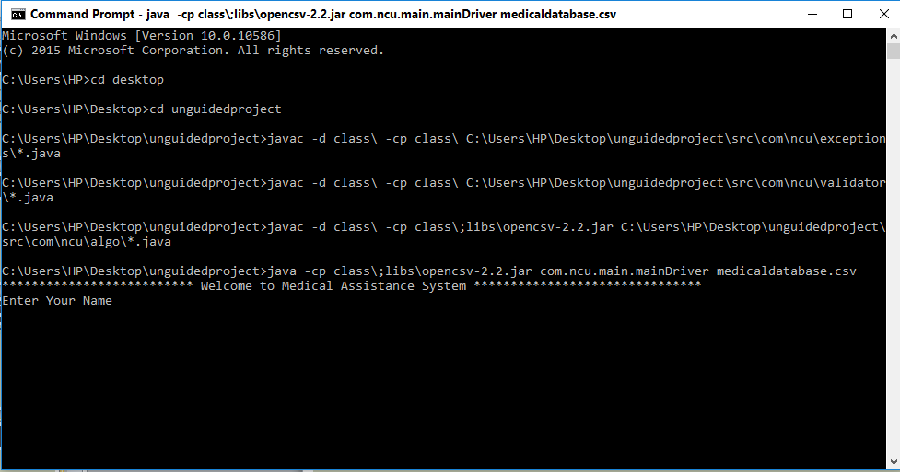
output

Slide 53
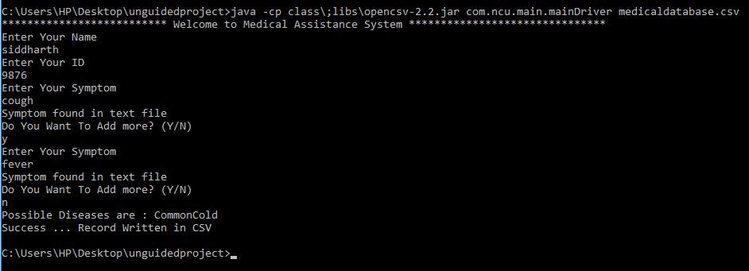
output

Slide 54
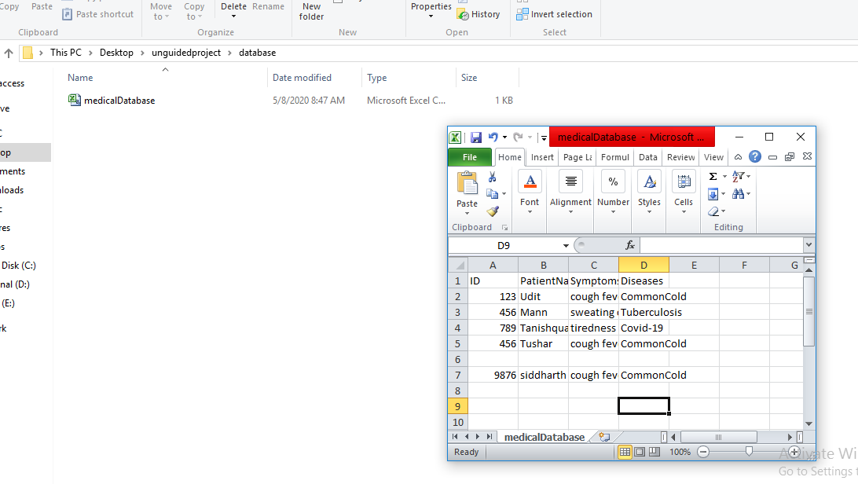
Data recorded in csv file

Slide 55
Thank
you

